Slide 1
Cigarettes
Statistical Programming
Lesson 10 Final Project
Sarah Hagans

Slide 2
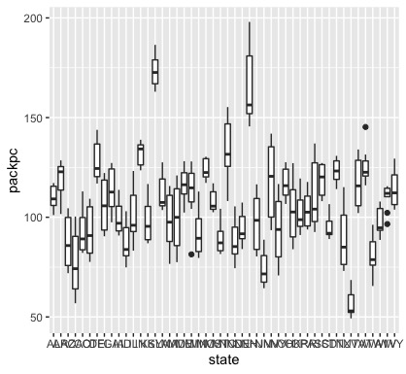
Packs Per Capita by State

Slide 3
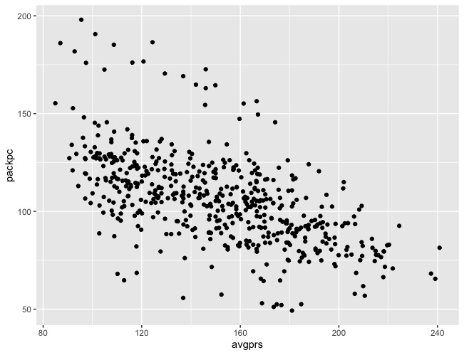
There is a negative correlation with moderate strength between pack per capita and price per pack

Slide 4
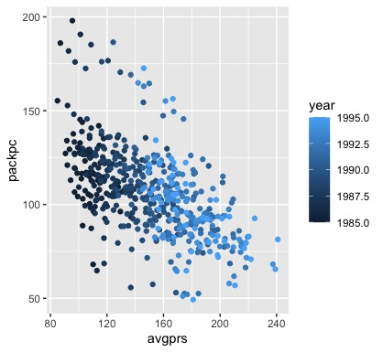
Pearson's product-moment correlation data: Cigarette$avgprs and Cigarette$packpc t = -16.562, df = 526, p-value < 2.2e-16 alternative hypothesis: true correlation is not equal to 0 95 percent confidence interval: -0.6388606 -0.5264104 sample estimates: cor -0.5854443

Slide 5
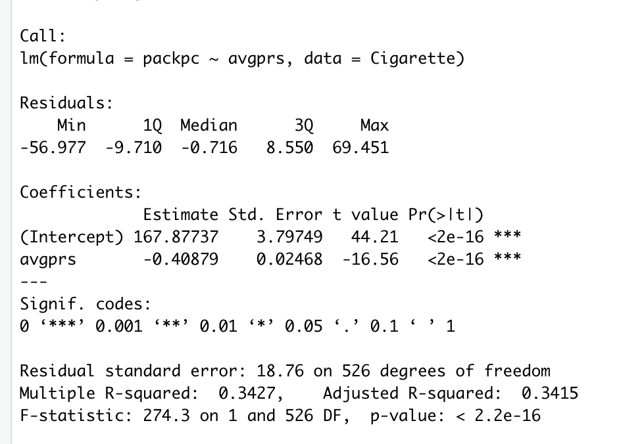
Linear Regression
The negative avgprs estimate backs the negative correlation.
The p-value is significant.
The adjusted R-squared value suggests the line explains 34% of the variability.

Slide 6
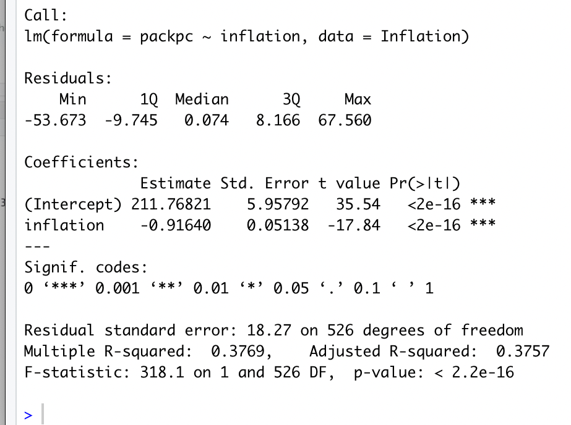
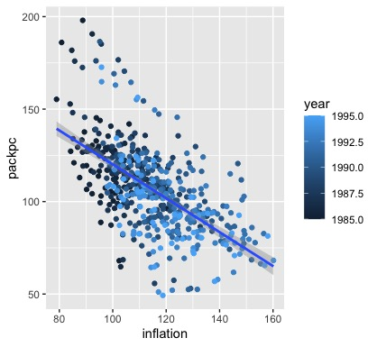
Adjusting For Inflation
This increased the slope of the line and the correlation strength.

Slide 7
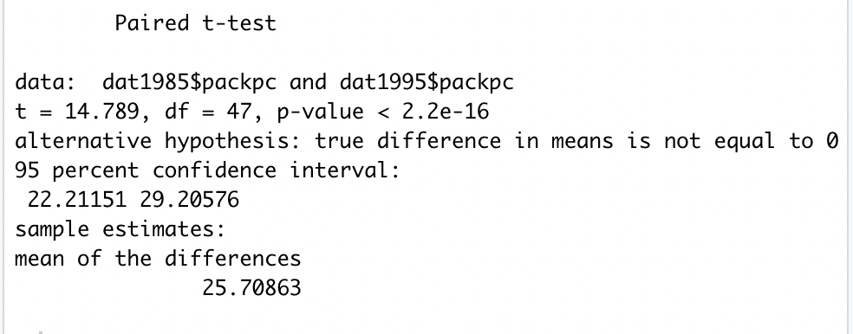
A t-test of Packs per Capita in 1985 and 1995
There appears to be a significant difference between 1985 and 1995.

